Slide 1
Computer Networks II Application Layer Basic Architectures, DNS
Amitangshu Pal
Computer Science and Engineering
IIT Kanpur

Slide 2













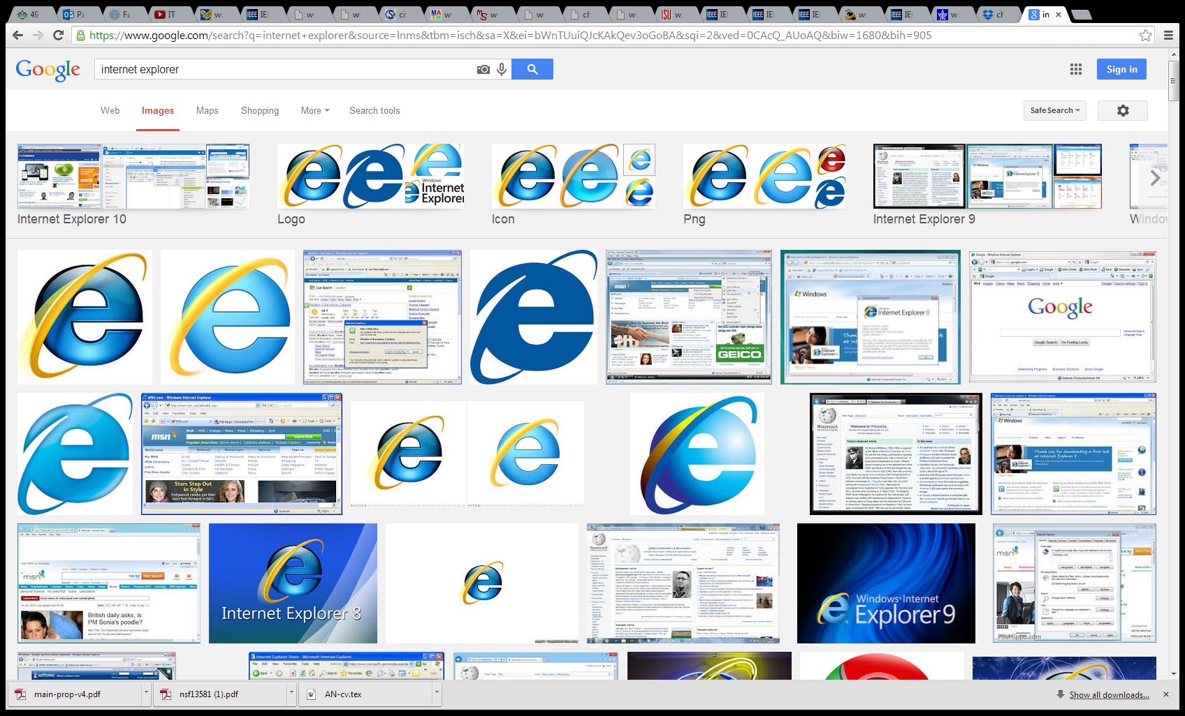

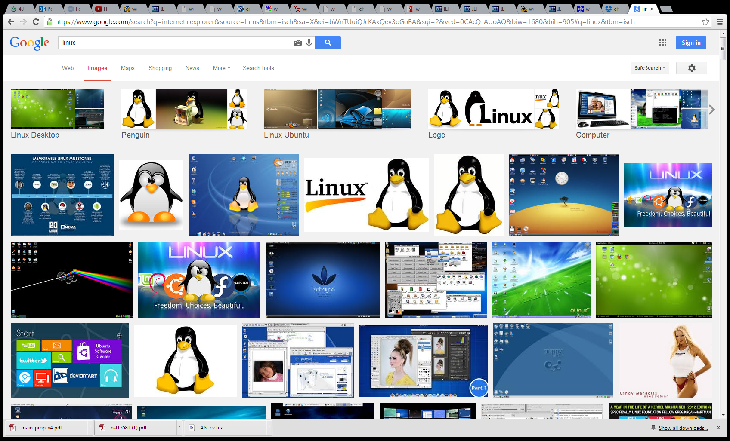
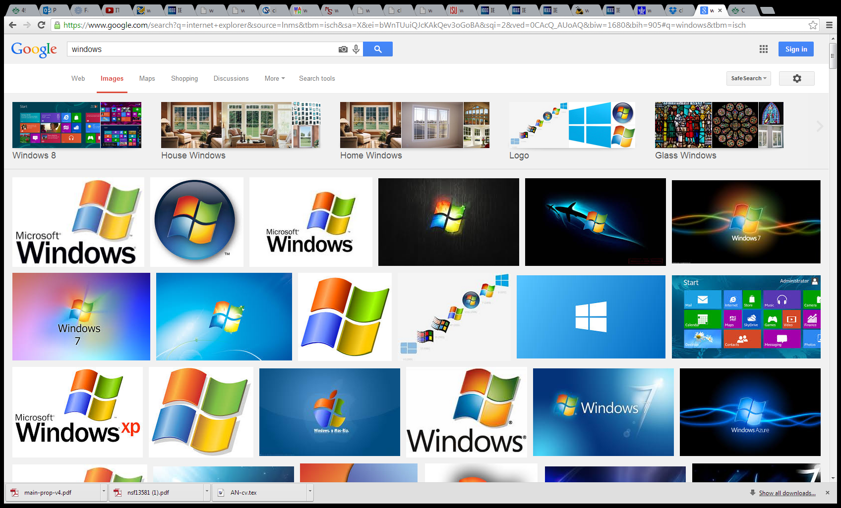
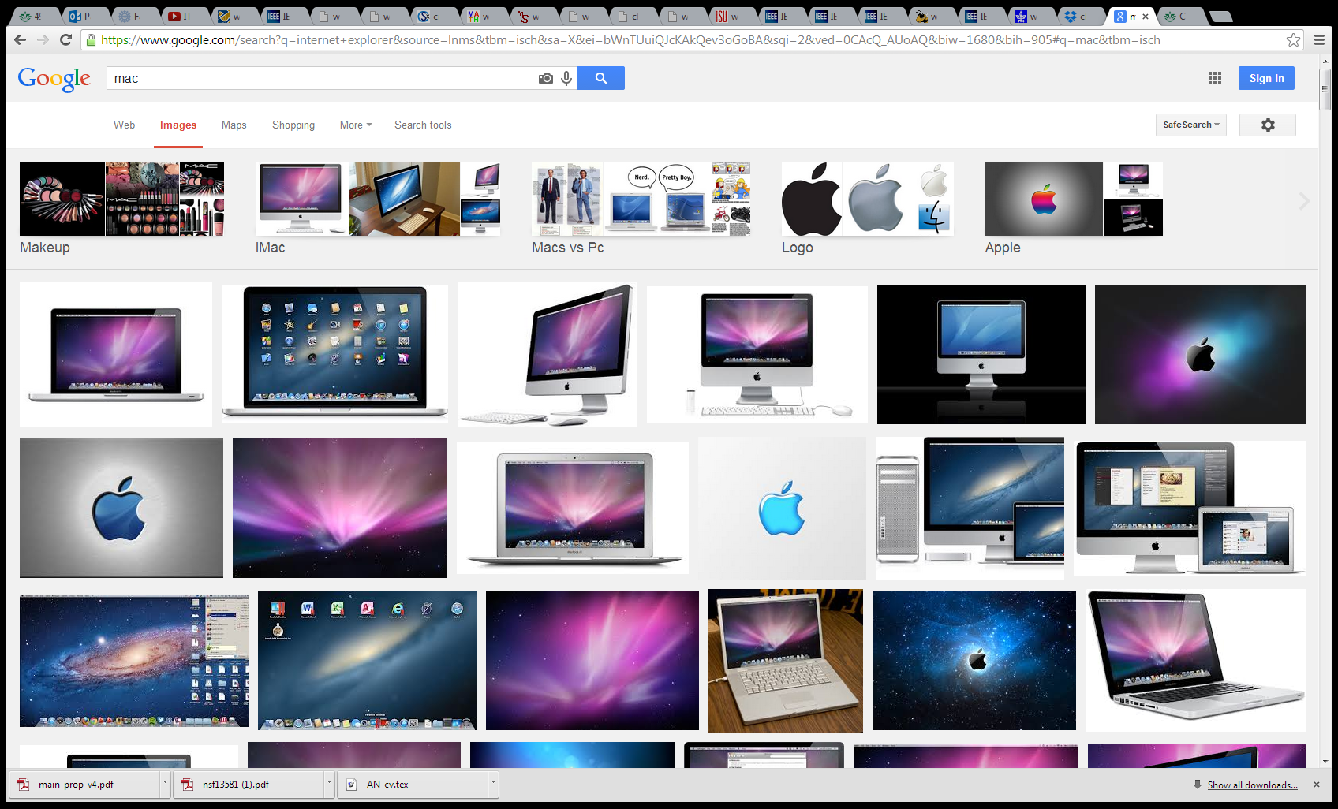



Creating a Network App
application
transport
network
data link
physical
mobile network
national or global ISP
Application programs run on end systems
Network-core devices do not run user applications
Communicate over network
Web server software communicates with browser software
local or regional ISP
User Processes
Application
application
home network
content
provider
network
application
transport
network
data link
physical
Operating Systems
application
transport
network
data link
physical
datacenter
network
transport
Transport
Network
network
enterprise
network

Slide 3
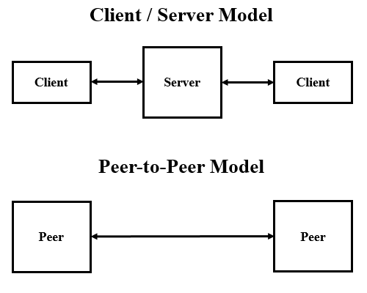
Application architectures
Possible structure of applications:
Client-server
Peer-to-peer (P2P)
Src: https://commons.wikimedia.org/wiki/File:Client-server_Vs_peer-to-peer_-_en.png

Slide 4
Client-server architecture
mobile network
national or global ISP
Server:
Always-on host
Permanent IP address
Data centers for scaling
Clients:
Communicate with server
May be intermittently connected
May have dynamic IP addresses
Do not communicate directly with each other
Examples: HTTP, FTP, IMAP
local or regional ISP
home network
content
provider
network
datacenter
network
enterprise
network

Slide 5
P2P architecture
mobile network
national or global ISP
No always-on server
Arbitrary end systems directly communicate
Peers request service from other peers, provide service in return to other peers
Self scalability – new peers bring new service capacity, as well as new service demands
Peers are intermittently connected and change IP addresses
Complex management
Examples: P2P file sharing (BitTorrent)
local or regional ISP
home network
content
provider
network
datacenter
network
enterprise
network

Slide 6

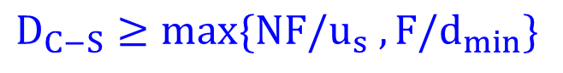
File Distribution Time: Client-server
u_{s}: Server upload capacity
File size F
u₁
d₁
u₂
d_{i}: Peer i download capacity
u_{s}
d₂
Server
Network
(with abundant bandwidth)
d_{i}
u_{N}
u_{i}
d_{N}
u_{i}: Peer i upload capacity
$$D_{C−S}≥max\{NF/u_{s} , F/d_{min}\}$$

Slide 7
File Distribution Time: P2P
u_{s}: Server upload capacity
File size F
u₁
d₁
u₂
d_{i}: Peer i download capacity
u_{s}
d₂
Server
Network
(with abundant bandwidth)
d_{i}
u_{N}
u_{i}
d_{N}
u_{i}: Peer i upload capacity
$$D_{P2P}≥max\{F/u_{s} , F/d_{min}, NF/(u_{s}+∑u_{i} )\}$$

Slide 8
Client-server vs. P2P
Client upload rate = u
F/u = 1 hour
u_{s} = 10u
d_{min} ≥ u_{s}

Slide 9
What Transport Service Does an App Need?
Data integrity
Some apps (e.g., file transfer, web transactions) require 100% reliable data transfer
Other apps (e.g., audio) can tolerate some loss
Timing
Some apps (e.g., Internet telephony, interactive games) require low delay to be “effective”
Throughput
Some apps (e.g., multimedia) require minimum amount of throughput to be “effective”
Other apps (“elastic apps”) make use of whatever throughput they get
Why throughput is different than timing constraint?

Slide 10
Internet Apps: Types and Requirements
Application
File transfer
e-mail
Web documents
Real-time audio/video
Stored audio/video
Interactive games
Data loss
no loss
no loss
no loss
loss-tolerant
loss-tolerant
loss-tolerant
Throughput
elastic
elastic
elastic
audio: 5kbps-1Mbps
video:10kbps-5Mbps
same as above
few kbps up
Time sensitive
no
no
no
yes, 10’s msec
yes, few secs
yes, 10’s msec

Slide 11
Internet Apps: Application, Transport protocols
Application
layer protocol
SMTP [RFC 2821]
Telnet [RFC 854]
HTTP [RFC 2616]
FTP [RFC 959]
HTTP (e.g., YouTube), RTP [RFC 1889]
SIP, RTP, proprietary
(e.g., Skype)
Underlying
transport protocol
TCP
TCP
TCP
TCP
TCP or UDP
TCP or UDP
Application
e-mail
Remote terminal access
Web
File transfer
Streaming multimedia
Internet telephony

Slide 12
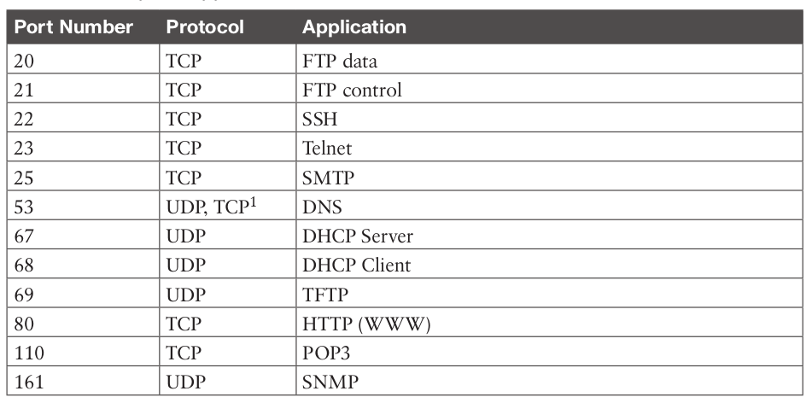
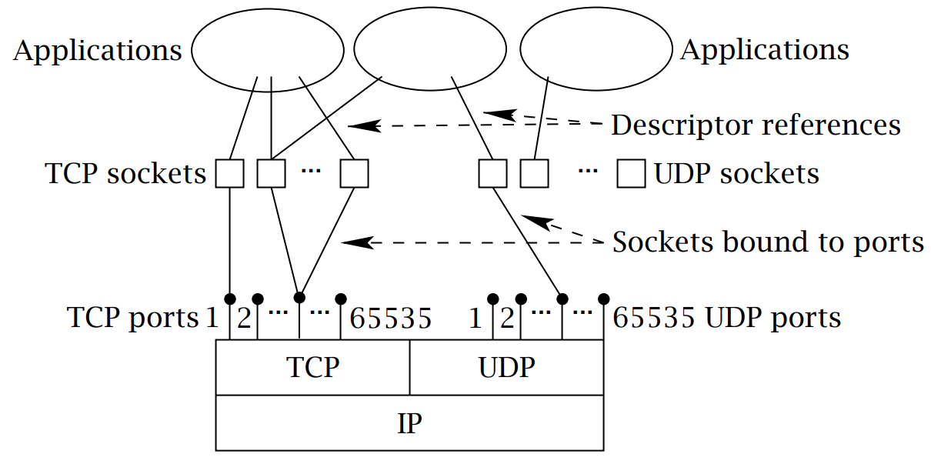
Internet Apps: Common Port Numbers
Application processes are identified by IP addresses and port numbers
Popular apps have well known port numbers
Src: https://linuxwheel.com/chapter-5-fundamentals-of-tcp-ip-transport-and-application/

Slide 13
Domain Name System (DNS)

Slide 14
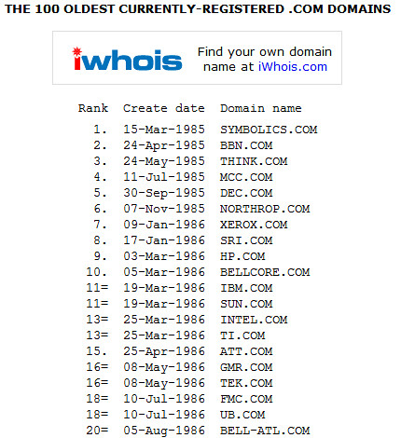
DNS: Domain Name System
Domain name: Identifies Internet resources, such as computers, networks, and services, with a text-based label
Human prefers hostnames/domain names
www.google.com - used by humans
Internet hosts, routers use IP addresses
DNS services: Hostname to IP address translation
Runs on UDP and uses port number 53
Src: https://www.flickr.com/photos/simonbarratt/106385627

Slide 15
DNS: A Distributed, Hierarchical Database
Root DNS Servers
Root
…
…
.com DNS servers
.org DNS servers
.edu DNS servers
Top Level Domain
…
…
…
…
yahoo.com
DNS servers
amazon.com
DNS servers
pbs.org
DNS servers
nyu.edu
DNS servers
umass.edu
DNS servers
Authoritative
Distributed database implemented in hierarchy of many name servers
Application-layer protocol: hosts, name servers communicate to resolve names (name → address translation)

Slide 16
DNS: A Distributed, Hierarchical Database
Root DNS Servers
Root
…
…
.com DNS servers
.org DNS servers
.edu DNS servers
Top Level Domain
…
…
…
…
yahoo.com
DNS servers
amazon.com
DNS servers
pbs.org
DNS servers
nyu.edu
DNS servers
umass.edu
DNS servers
Authoritative
Client wants IP for www.amazon.com:
Client queries root server to find .com DNS server
Client queries .com DNS server to get amazon.com DNS server
Client queries amazon.com DNS server to get IP address for www.amazon.com

Slide 17
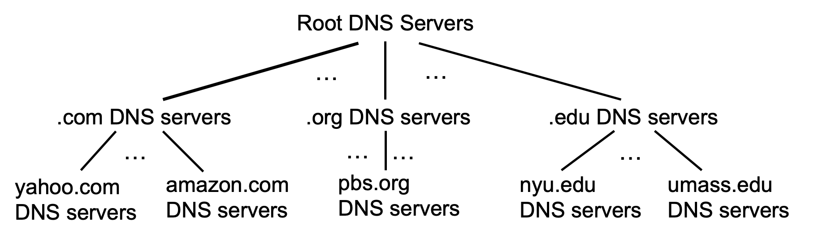
DNS: Root Name Servers
Contacted by local name server that can not resolve name
Root name server:
Provides IP addresses of the TLD servers
ICANN (Internet Corporation for Assigned Names and Numbers) manages root DNS domain

Slide 18
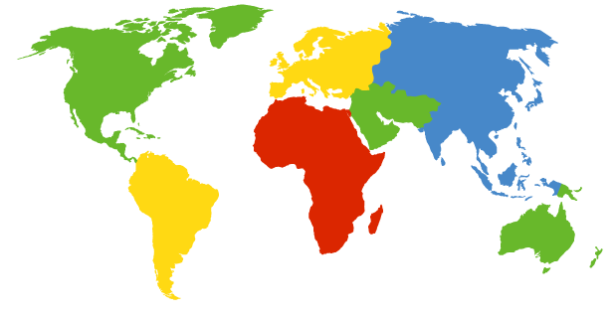
DNS: Root Name Servers
13 logical root name “servers” worldwide
Each “server” replicated many times
c. Cogent, Herndon, VA (5 other sites)
d. U Maryland College Park, MD
h. ARL Aberdeen, MD
j. Verisign, Dulles VA (69 other sites )
k. RIPE London (17 other sites)
i. Netnod, Stockholm (37 other sites)
e. NASA Mt View, CA
f. Internet Software C.
Palo Alto, CA (and 48 other sites)
m. WIDE Tokyo
(5 other sites)
a. Verisign, Los Angeles CA
(5 other sites)
b. USC-ISI Marina del Rey, CA
l. ICANN Los Angeles, CA
(41 other sites)
g. US DoD Columbus, OH (5 other sites)

Slide 19
TLD, Authoritative Servers
Top-level Domain (TLD) Servers:
Responsible for com, org, net, edu, and all top-level country domains, e.g.: in, uk, fr, ca, jp
Verisign Global Registry Services maintains the TLD servers for the .com domain
Educause maintains the TLD servers for the .edu domain
Authoritative DNS servers:
Organization’s own DNS server(s), providing authoritative hostname to IP mappings for organization’s named hosts
Can be maintained by organization or service provider

Slide 20
Local DNS Name Server
Does not strictly belong to hierarchy
Each ISP (residential ISP, company, university) has one or more local DNS servers
Also called “default name server”
When host makes DNS query, query is sent to its local DNS server
Has local cache of recent name-to-address translation pairs
Acts as proxy, forwards query into hierarchy

Slide 21
DNS Name Resolution
Root DNS server
Iterated query:
Contacted server replies with name of server to contact
“I don’t know this name, but ask this server”
2
3
TLD DNS server
4
5
Local DNS server
7
6
1
8
Authoritative DNS server
Requesting host

Slide 22
DNS Name Resolution
Root DNS server
2
3
Recursive query:
Puts burden of name resolution on contacted name server
Heavy load at upper levels of hierarchy
7
6
TLD DNS
server
Local DNS server
5
4
1
8
Authoritative DNS server
Requesting host

Slide 23
DNS: Caching, Updating Records
Once (any) name server learns mapping, it caches mapping
Cache entries timeout (disappear) after some time (TTL)
TLD servers typically cached in local name servers
Thus root name servers not often visited

Slide 24
DNS Services
DNS services:
Hostname-to-IP-address translation
Host aliasing
Canonical, alias names
Many names may map to same IP address
Mail server aliasing
hotmail.com → relay1.west-coast.hotmail.com
Load distribution
Replicated Web servers: many IP addresses correspond to one name

Slide 25
DNS: Distributed Database Storing Resource Records (RR)
RR format: (name, value, type, ttl)
type=A
name is hostname
value is IP address
; Authoritative data for cs.vu.nl
cs.vu.nl. 86400 IN MX 1 zephyr
cs.vu.nl. 86400 IN MX 2 top
cs.vu.nl. 86400 IN NS star
star 86400 IN A 130.37.56.205
zephyr 86400 IN A 130.37.20.10
top 86400 IN A 130.37.20.11
www 86400 IN CNAME star.cs.vu.nl
ftp 86400 IN CNAME zephyr.cs.vu.nl
type=NS
name is domain (e.g., foo.com)
value is hostname of authoritative name server for this domain

Slide 26
DNS: Distributed Database Storing Resource Records (RR)
RR format: (name, value, type, ttl)
type=CNAME
name is alias name for some “canonical” (the real) name
value is canonical name
; Authoritative data for cs.vu.nl
cs.vu.nl. 86400 IN MX 1 zephyr
cs.vu.nl. 86400 IN MX 2 top
cs.vu.nl. 86400 IN NS star
star 86400 IN A 130.37.56.205
zephyr 86400 IN A 130.37.20.10
top 86400 IN A 130.37.20.11
www 86400 IN CNAME star.cs.vu.nl
ftp 86400 IN CNAME zephyr.cs.vu.nl
type=MX
value is name of SMTP mail server associated with name

Slide 27
DNS Query and Reply Messages
2 bytes
2 bytes
Message header:
Identification: 16 bit # for query, reply to query uses same #
Flags:
Query or reply
Recursion desired
Recursion available
Reply is authoritative
identification
flags
# questions
# answer RRs
# authority RRs
# additional RRs
questions (variable # of questions)
answers (variable # of RRs)
authority (variable # of RRs)
additional info (variable # of RRs)

Slide 28
DNS Query and Reply Messages
2 bytes
2 bytes
identification
flags
# questions
# answer RRs
# authority RRs
# additional RRs
Name, type fields for a query
questions (variable # of questions)
RRs in response to query
answers (variable # of RRs)
Records for authoritative servers
authority (variable # of RRs)
Additional “ helpful” info that may be used
additional info (variable # of RRs)

Slide 29
Getting Your Info into the DNS
Example: new startup “Network Utopia”
Register name networkuptopia.com at DNS registrar
Provide names, IP addresses of authoritative name server (primary and secondary)
Registrar inserts NS, A RRs into .com TLD server:
(networkutopia.com, dns1.networkutopia.com, NS)
(dns1.networkutopia.com, 212.212.212.1, A)
Create authoritative server locally with IP address 212.212.212.1
Type A and MX records for www.networkuptopia.com

Slide 30
Summary
Application architectures:
Client-server model
Peer-to-peer model
DNS:
Hostname to IP address mapping

